Slide 1
Housing First + Homelessness in Charlottesville

Slide 2
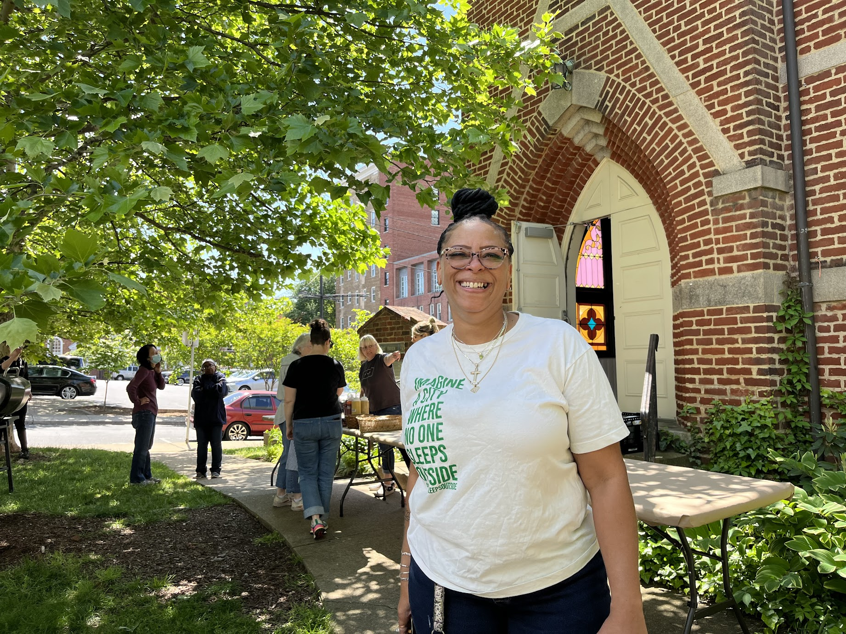
Laura DeLapp
Day Shelter Manager
Housing Advocate
Community Treasure
Amazing Human
Shelter For Help in Emergency 24-hour hotline: (434) 293-8509

Slide 3
Overview
Presentation~25min
Define terms!
Review current data about homelessness
Discuss The Haven’s role in addressing homelessness using Housing First interventions
Q+A~30 min

Slide 4
Defining Terms!
“Locally”
Homeless
Chronically homeless

Slide 5
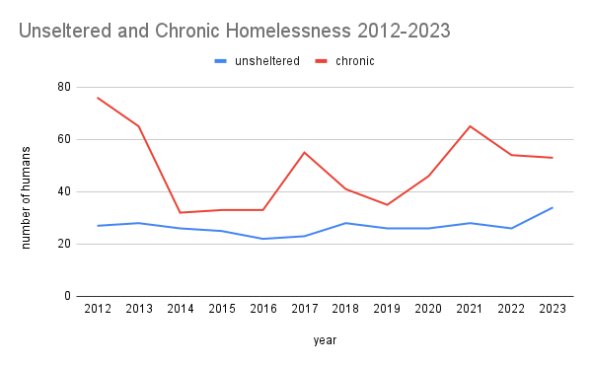
PIT Counts

Slide 6
By-Name List (BNL) April 2022- March 2023
459 total people over a year
200 total people at a given time

Slide 7
Local Shelter Capacity
 | 22-23 season | 23-24 season
PACEM seasonal congregate | 35 | 50
PACEM overflow at SA | 16 | 12
Premier Circle | 14 | 0
SA congegate | 56 | 56
SA family | 10 | 0
BRACH funded Royal Inn | 20 | 0
City Emergency Hotel Rooms | 5 | 5
TOTAL | 156 | 123
unsheltered at PIT | 34 | ???

Slide 8
Housing First at The Haven
Everyone can thrive in housing!
Housing is fundamental to a healthy life!
Everyone is housing ready!

Slide 9
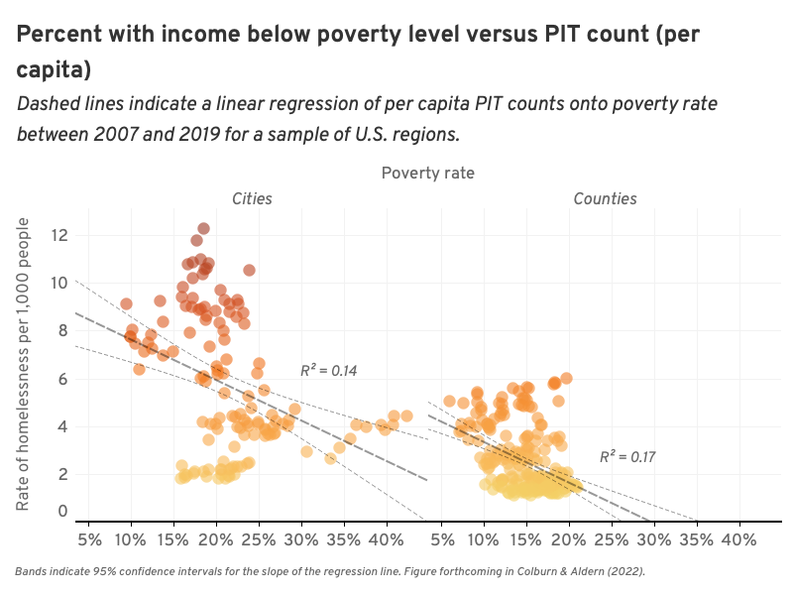
Why Housing First?

Slide 10
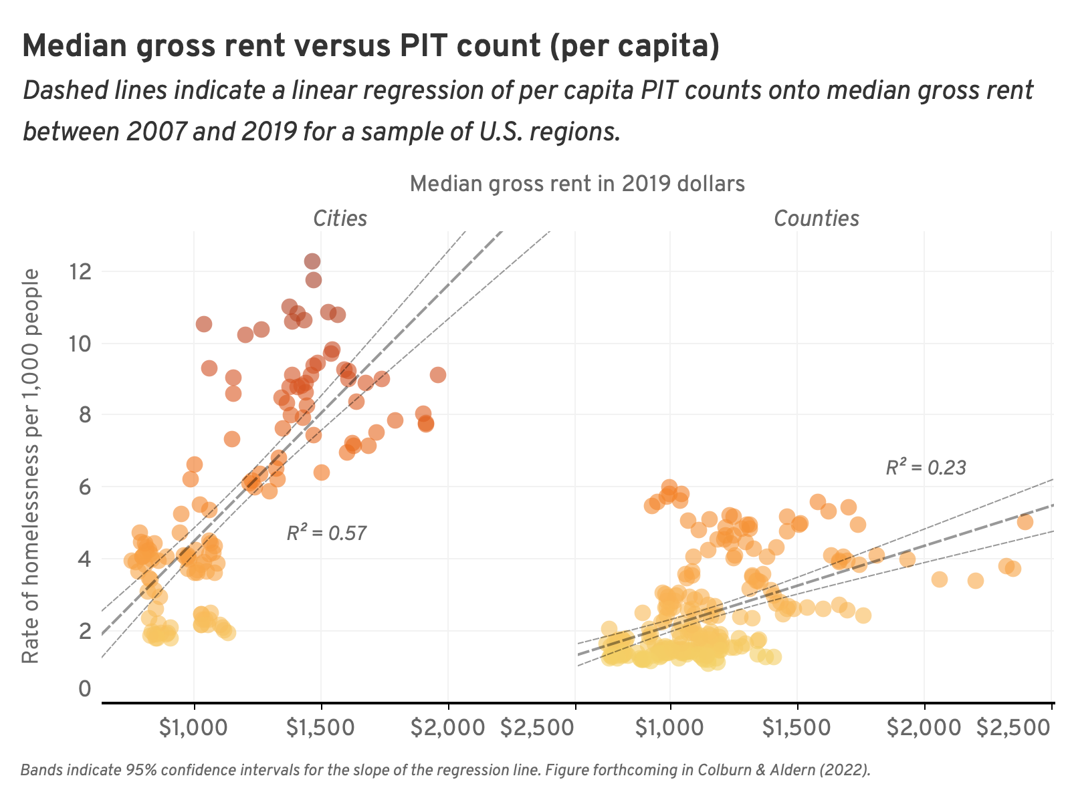
Why Housing First?

Slide 11
Housing First Successes

Slide 12
Housing First Challenges + Next Steps

